Slide 1
ColorFlow 7.5
Harmony to ColorFlow 7.5 Migration
Paul Kong
UWS SERVICE OPERATIONS L3

Slide 2




Why migrate to ColorFlow?
Harmony is a legacy product that has not been updated for a number of years
One application for tonal calibration and color relationship management
  Do more: evolve from simple tonal calibration
  to grey-balance calibration (i.e. G7)
  Edit by the numbers using lab dot gain or optional Visual color editing for accurate on-screen color when editing profiles and curves
  Comprehensive print condition reporting tools
  Fully endorses ISO printing system standardization recommendations, and supports international data exchange formats and job control specifications

Slide 3

Be Ahead Of Your Competition
Take advantage of the ColorFlow technologies and intuitive user interface to stay ahead of your competition
Take the guessing out of curves management and characterize all your presses using ColorFlow

Slide 4
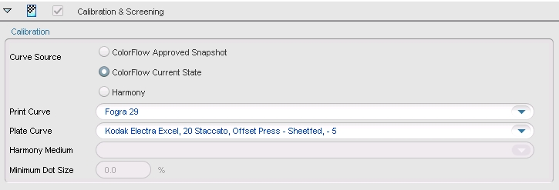
What’s new with ColorFlow tonal calibration in Prinergy 7.5?
ColorFlow no longer needs to be enabled for Prinergy Jobs
Tonal Calibration can be separated from Color Relationship Management (CRM)
New Curve Source in Process Templates, switch between ColorFlow or Harmony curves at any time

Slide 5
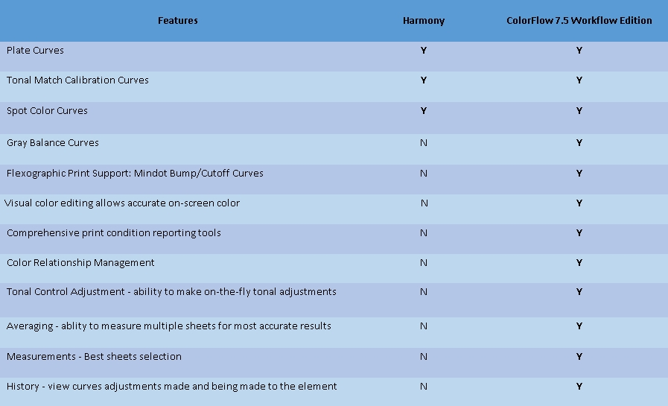
Features comparison at a glance

Slide 6
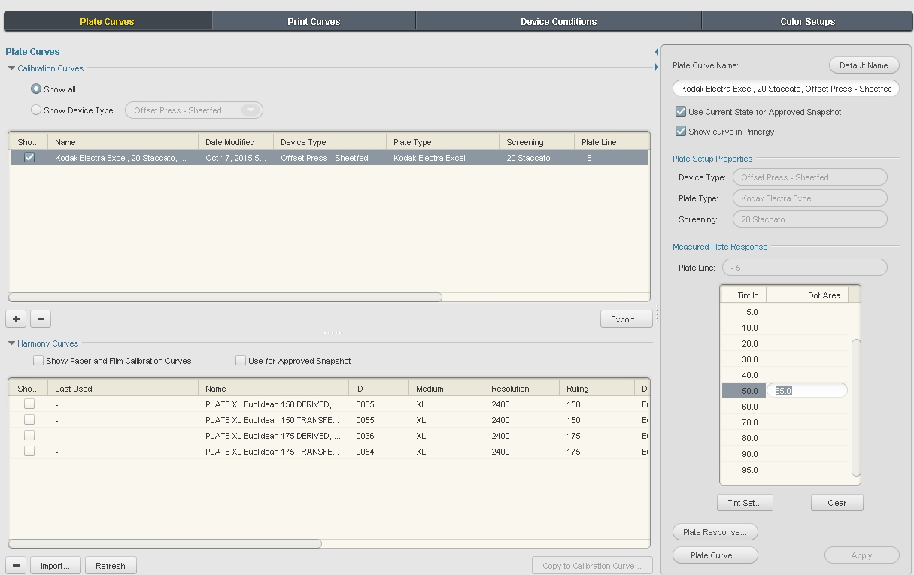
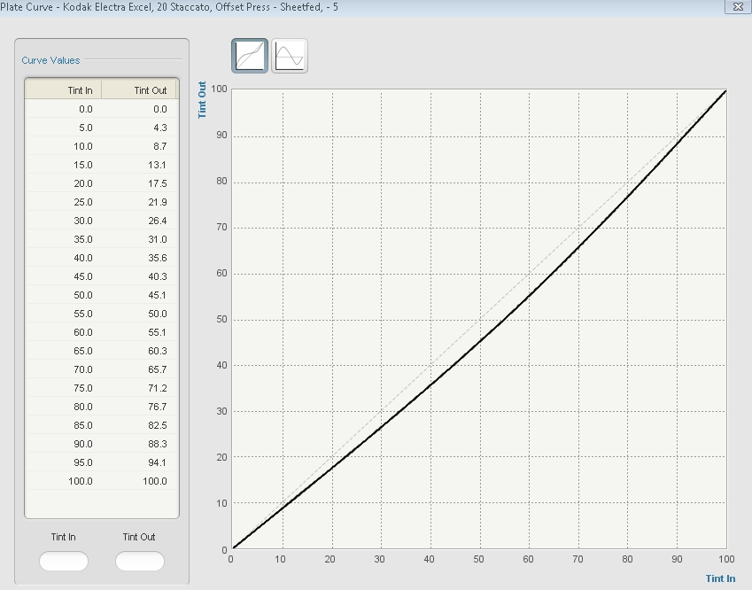
ColorFlow Plate Curves

Slide 7
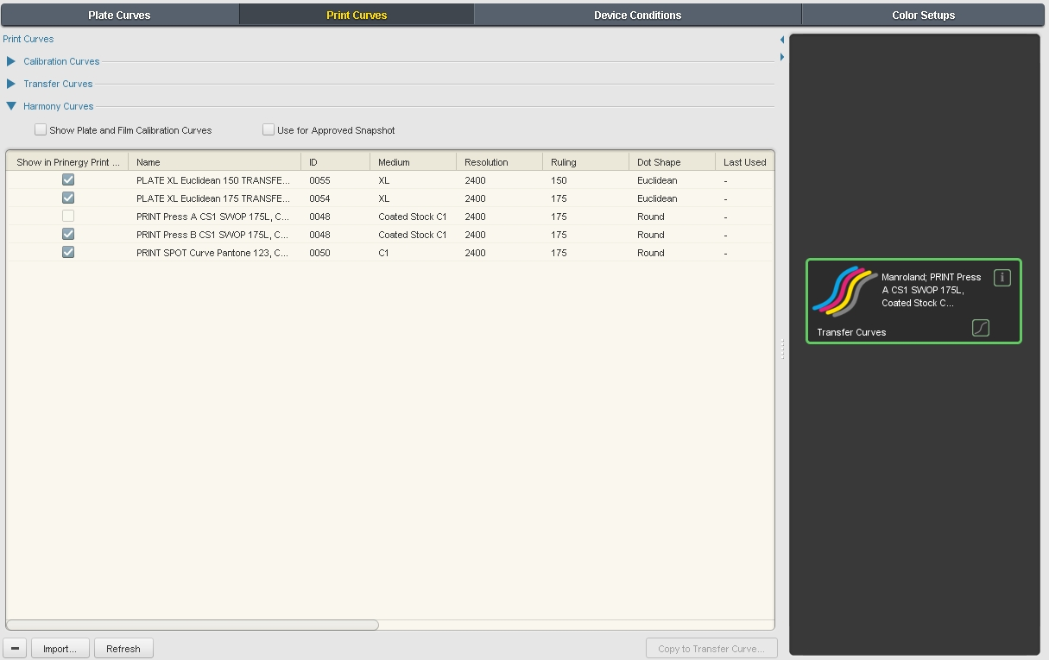
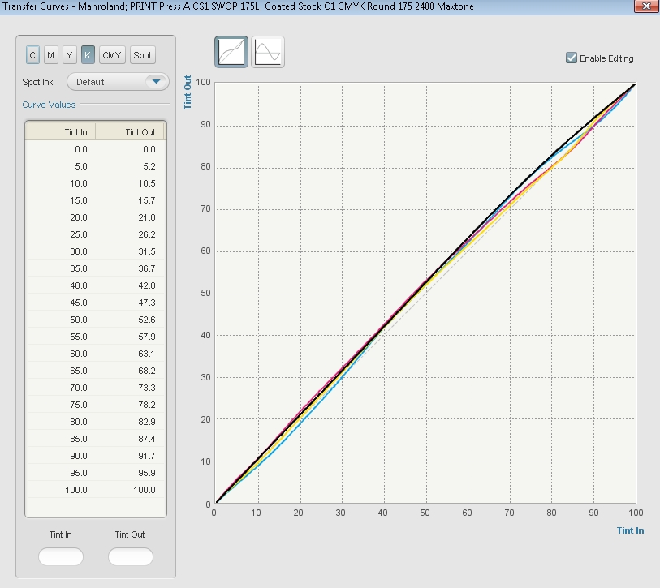
ColorFlow Print Curves

Slide 8
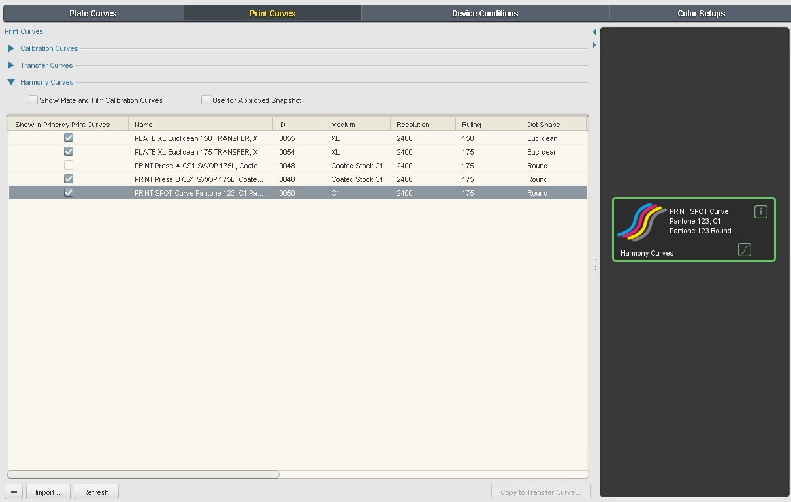
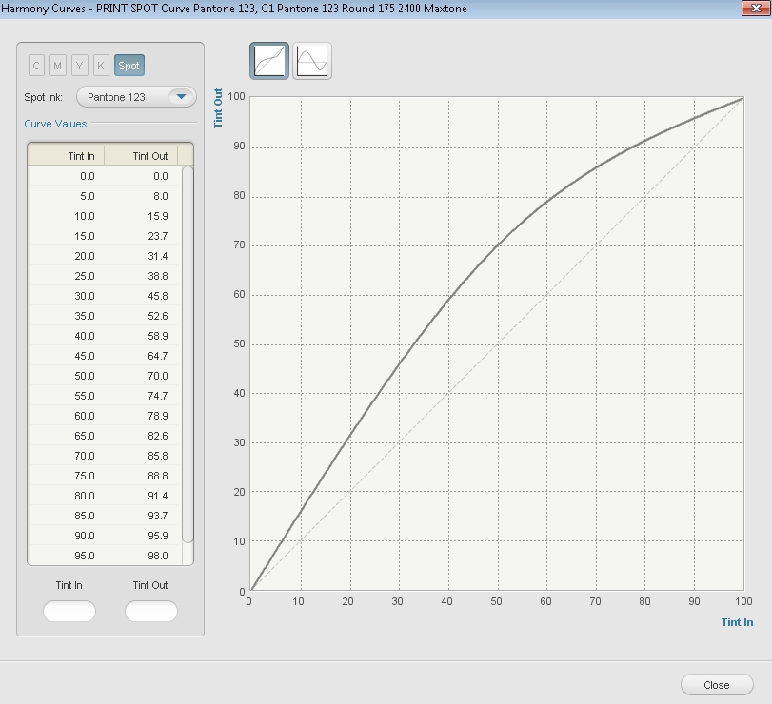
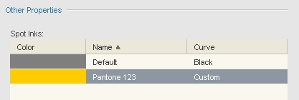
ColorFlow Spot Curves

Slide 9
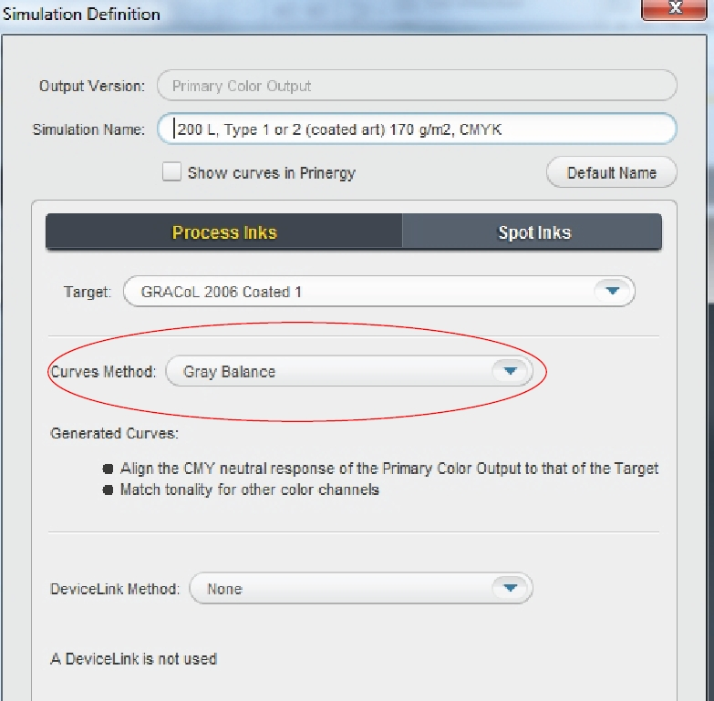
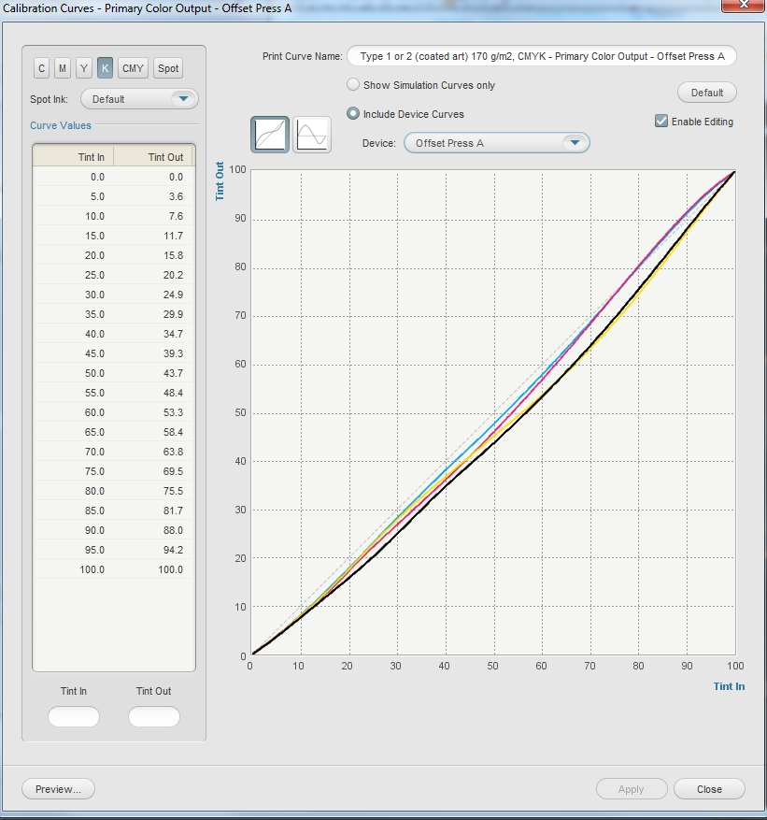
ColorFlow Gray Balance Curves
Gray balance curves using unique algorithms for a balanced color match: better color and faster.

Slide 10
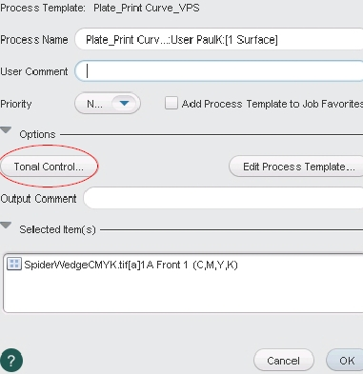
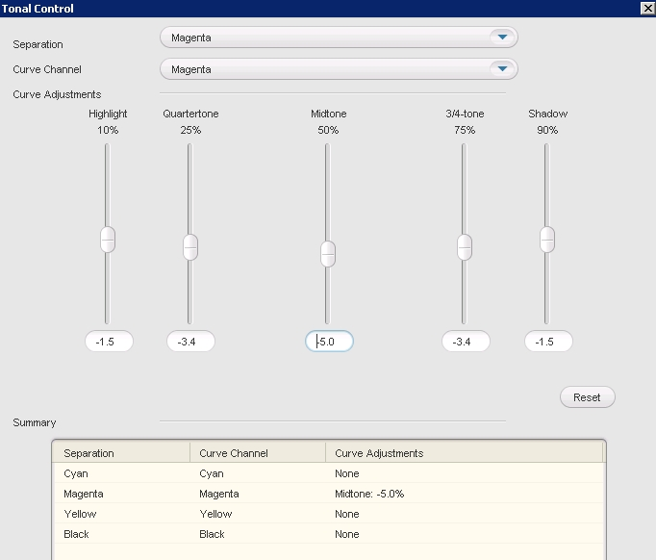
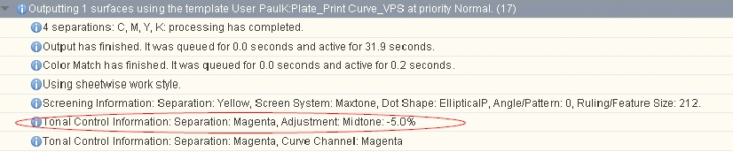
Tonal Control Adjustment
Ability to make on-the-fly tonal adjustments
History tracks the edits made in the Tonal Control

Slide 11
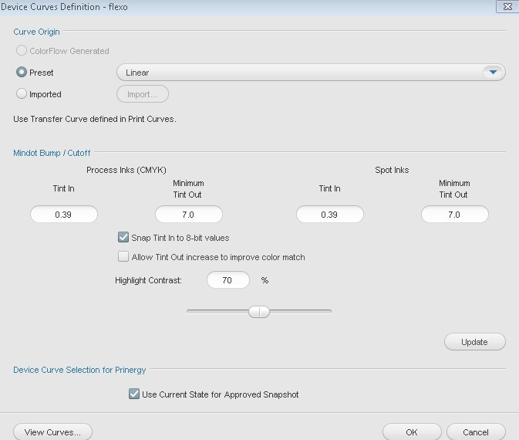
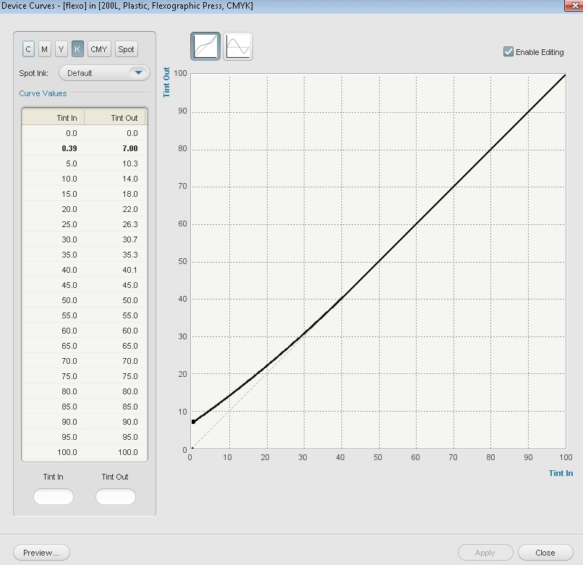
ColorFlow Flexo Support
Mindot Bump/Cutoff Curves

Slide 12
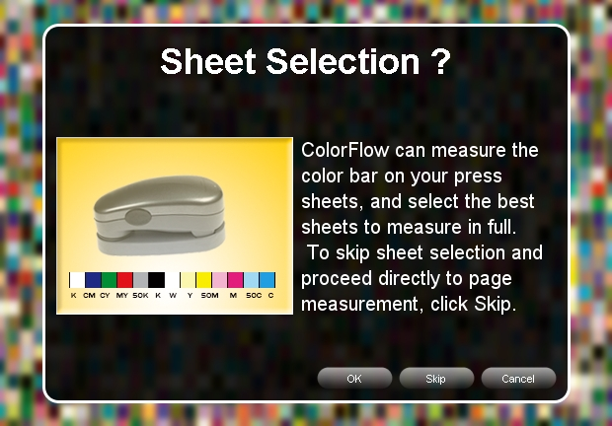
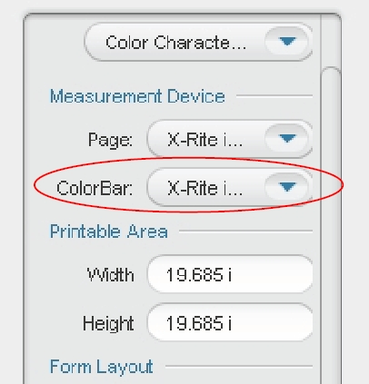
Best Sheets Selections
ColorFlow can measure the color bar on your press sheets, and select the best sheets to measure in full.

Slide 13
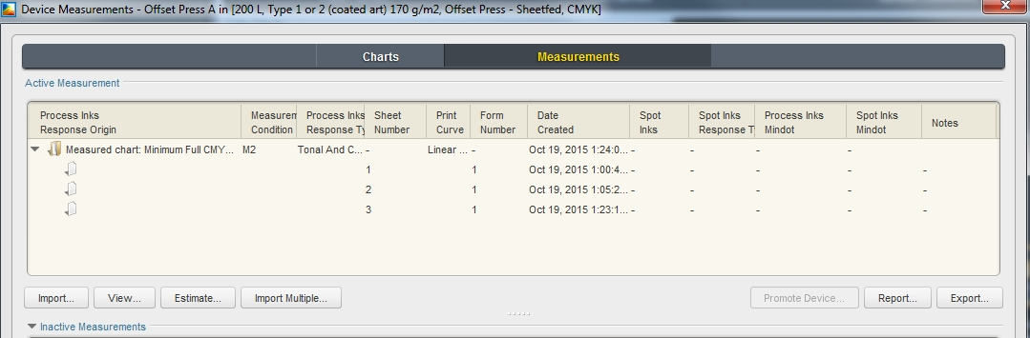
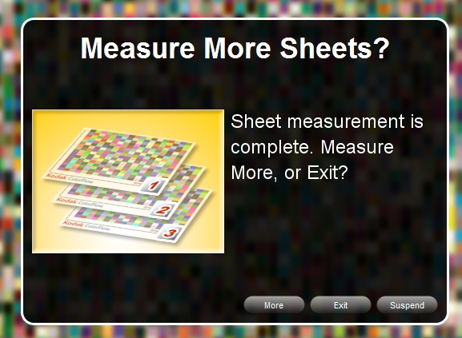
Measurements - Averaging
ColorFlow will allow you to measure multiple sheets to capture the most accurate data

Slide 14
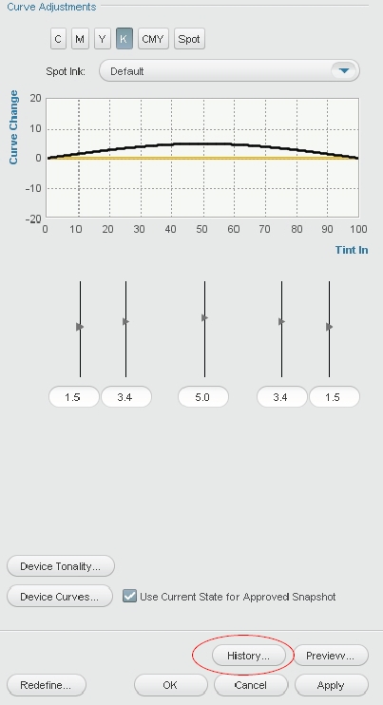
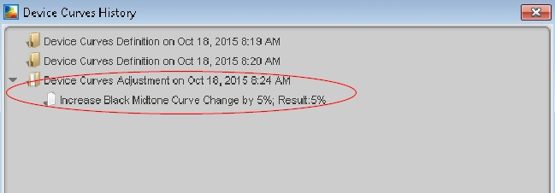
Curves Adjustments-History
ColorFlow will allow you to view curves adjustments made and being made to the element

Slide 15
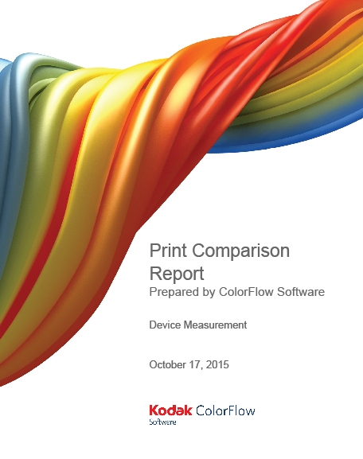
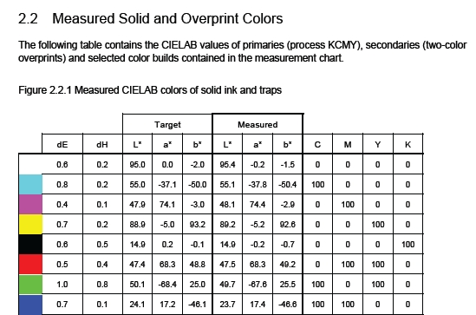
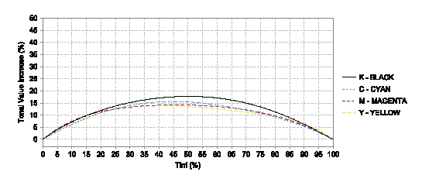
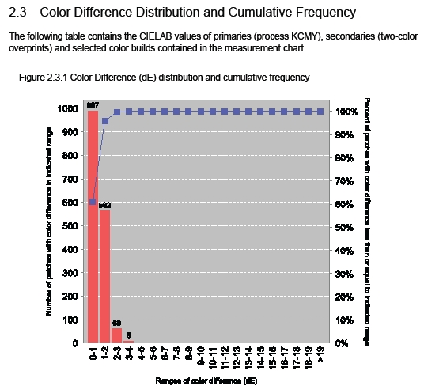
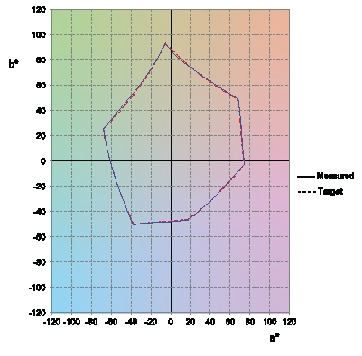
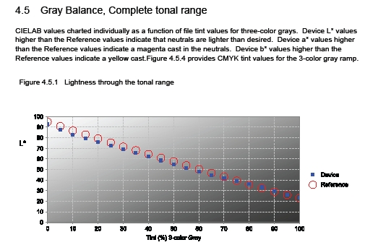
Comprehensive Print Condition Reports

Slide 16
Best Of All
It’s FREE
ColorFlow 7.5 Workflow Edition is included with Prinergy 7.5 free of charge.

Slide 17
ColorFlow Software Configurations
Kodak ColorFlow Software Workflow Edition for Kodak Prinergy Workflow System
Kodak ColorFlow Software Pro Workflow Edition for Kodak Prinergy Workflow System

Slide 18
ColorFlow Pro Workflow Edition
Pro Workflow Edition for Kodak Prinergy Workflow System
  Chargeable upgrade for Prinergy Workflow
  All the functionality of the ColorFlow Workflow Edition, plus the ability to create ICC device profiles and ICC DeviceLink profiles
  Support for flexographic printing (in version 2.0 and later)
  ColorFlow Software client runs on Windows and MacOS platforms
  ColorFlow Software database resides on the Prinergy Server
  Includes ColorMatch on Output for Prinergy

Slide 19
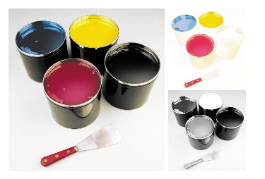
Key Option
ColorFlow Pro Edition Software with Ink Optimizing Solution
Users generate ICC DeviceLinks to apply various levels of Gray Component Replacement (GCR). This limits total area ink coverage, resulting in improved print stability on press and reduced ink consumption.

